Slide 1
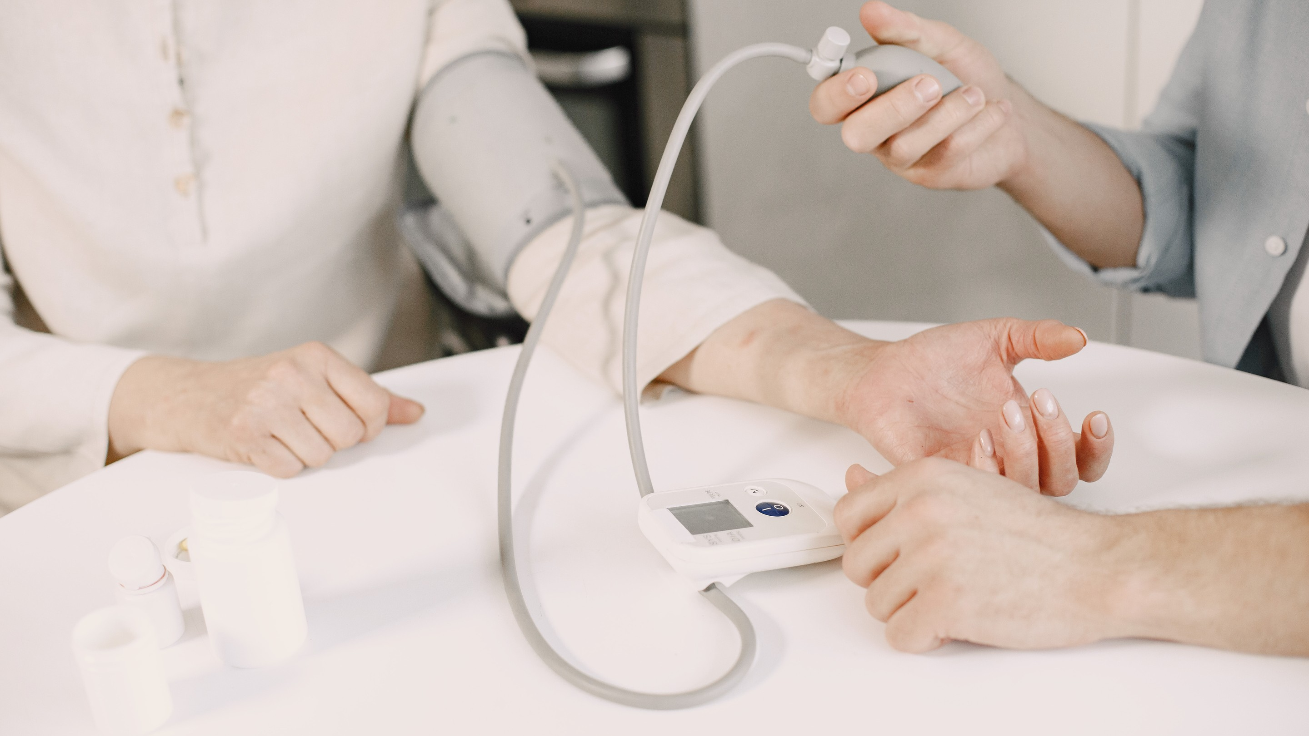

IOT Based VITAL
Health
Monitoring System
A Smart Approach to Healthcare

Slide 2
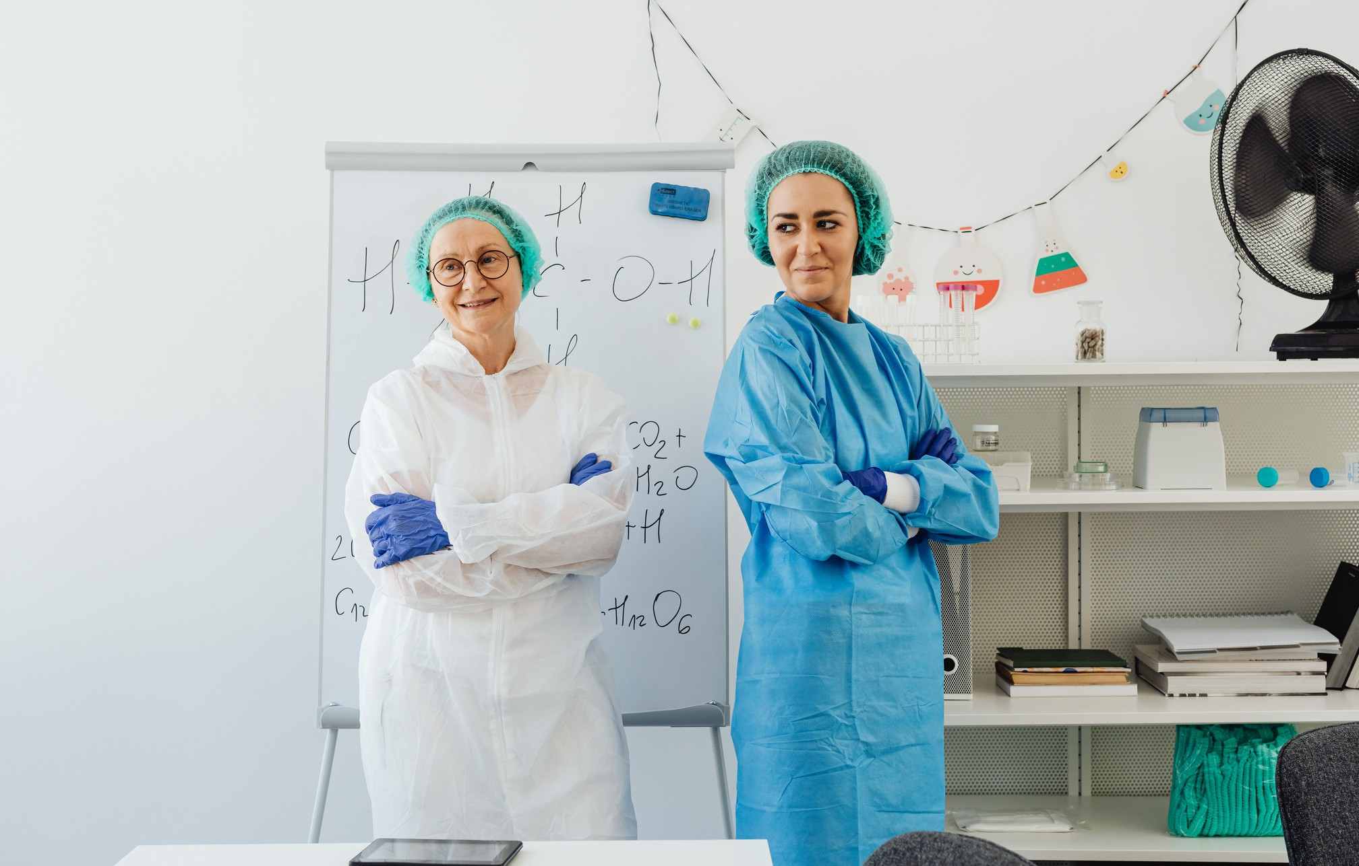




Team TechQuilla
Govind Ballabh Pant Instittute of Engineering and Technology, Pauri Garhwal
Team Members
Ananay Gupta ( Team Lead ) Arjun Badola
Deepanshu Chauhan Tushar Lingwal Dikshita Bisht
Instant Virtual Consultations
Instant Reports
Monitor Your Health Vitals
Report to Doctor For Consultations

Slide 3

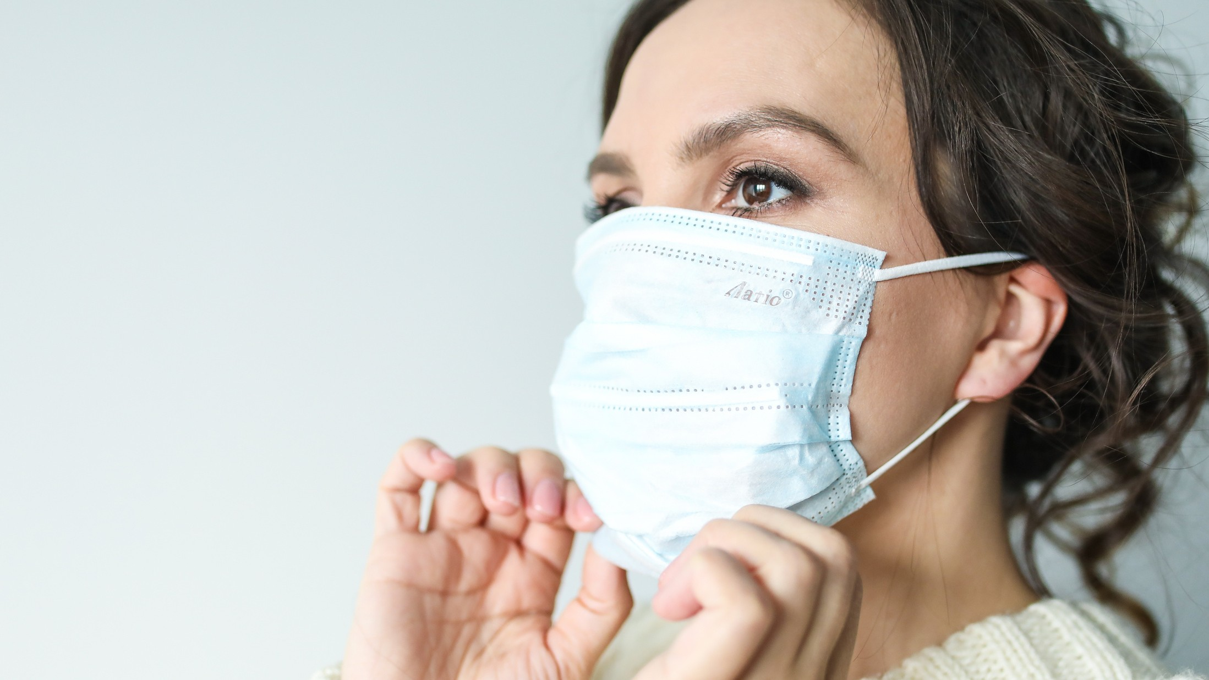
Problem Statement
India accounts for approximately 60 per cent of
the world's heart disease burden.
The rate of Coronary Incidences has risen from 1.6 per cent to 7.4 per cent in Rural People and from 1 per cent to 13.2 per cent in Urban Populations.
In global health index, India is ranked 66 out of 195 countries with an overall Index score of 42.8.
Almost 122 Indians per 100,000 die due to poor quality of Healthcare Services provided each year. The Rural and Hilly Areas of India contributes a major percentage in this ratio. This is mainly due to two factors:
. Lack of Awareness
. Lack of Availability
These diseases are life-threatening and require continuous monitoring of Health Parameters which in turn helps the Patient as well as the Doctor.

Slide 4
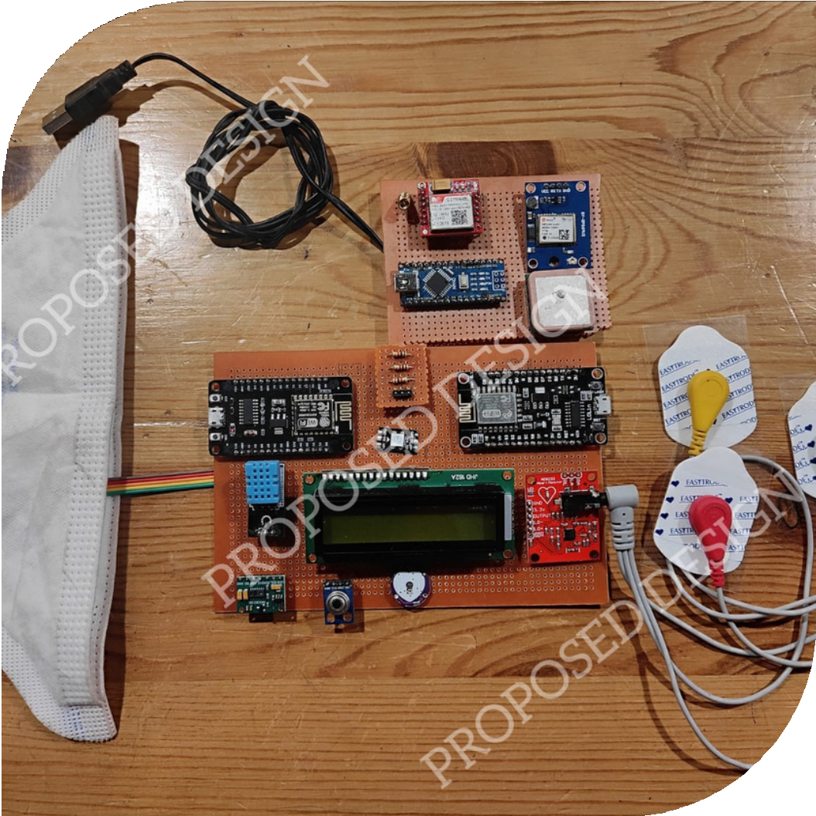
Problem Solution
Our Device 'SWAASTH Health Tracker' is a one stop solution for Monitoring Vital Health Parameters which are necessary for the treatment of any Human Being. Our Device is powered by State of the ART Technologies like IOT and Machine Learning.
These parameters are directly sent to the Patient's Heath Monitoring Custom Made Mobile Application. Patient can either export the Report for sending it to the Concerned Doctor or either send it to Our Virtual Doctor for Immediate Consultation.
These parameters include:
Body and Ambient Temperature Pulse Rate
Blood Oxygen Saturation Level (SpO2) Electro CardioGraphy (ECG) Respiration Rate
Humidity
SWASTH
Health Tracker

Slide 5
Problem Solution
.
This Device is made with Three Major Considerations:
Safety: The safety of an Individual is ensured by the device through constant monitoring of Various Parameters.
Connectivity: The Device is connected through a Dedicated SIM Card and a GPS Module that sends an Emergency Alert to the Family in case of Abnormality.
Consistency: The Device stores the past data of the Patient which
helps in the Future Monitoring of Diseases.
SWASTH
Health Tracker

Slide 6
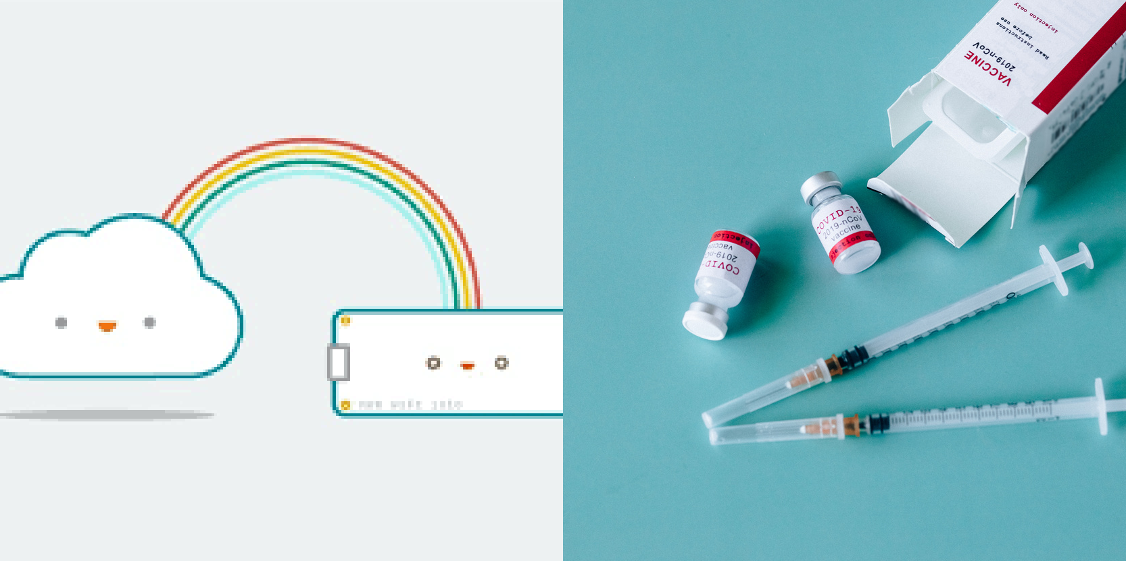
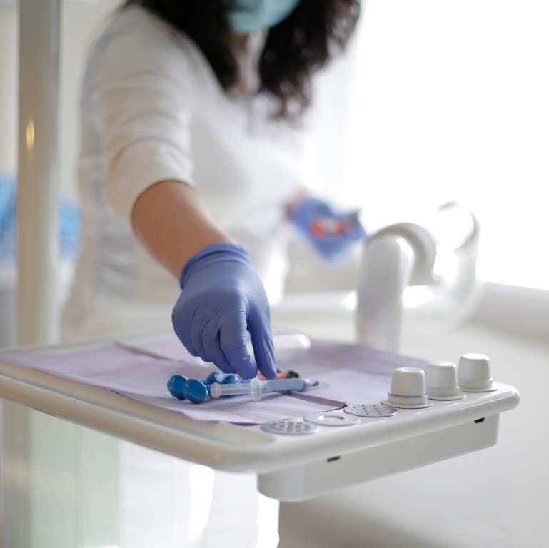

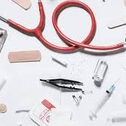
Technology Used
Internet of Things (IOT)
The Internet of Things, or IoT, is a system of interrelated computing devices, mechanical and digital machines, objects, animals or people that are provided with unique identifiers (UIDs) and the ability to transfer data over a network without requiring human-to-human or human-to- computer interaction.
Internet Of
Things (IOT)
Cloud Computing
Cloud Computing
Cloud computing is on-demand access, via the internet, to computing resources, applications, servers (physical servers and virtual servers), data storage, development tools, networking capabilities, and hosted at a remote data center managed by a Cloud Services Provider.

Slide 7
Technology Used
Machine Learning
Machine learning is a growing technology which enables computers to learn automatically from past data. Machine learning uses various algorithms for building mathematical models and making predictions using historical data or information. Currently, it is being used for various tasks such as image recognition, speech recognition, email filtering, Facebook auto-tagging, recommender system, and many more.
Neural Networks
Machine Learning
Neural Networks
Artificial neural networks (ANNs) are comprised of a node layers, containing an input layer, one or more hidden layers, and an output layer. Each node, or artificial neuron, connects to another and has an associated weight and threshold. If the output of any individual node is above the specified threshold value, that node is activated, sending data to the next layer of the network.

Slide 8
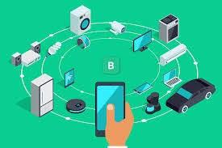

Tools Used
Software Requirements :
Blynkk IOT Cloud
Blynk is a low-code IoT software platform for connecting devices to the cloud, building mobile apps to remotely control and monitor them, and managing thousands of users and deployed products.
Heroku
Heroku is a platform as a service (PaaS) that enables developers to build, run, and operate applications entirely in the cloud. It is used here to deploy our State of the ART Machine Learning Models used by our Virtual Doctor.

Slide 9
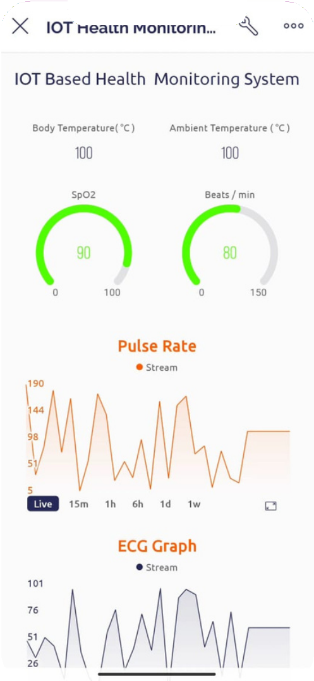
Tools Used
Software Requirements :
Google Collaboratory
Colaboratory is a Data Snalysis and Machine Learning tool that allows you to combine executable Python code and rich text along with charts, images, HTML, LaTeX and more into a single document stored in Google Drive. It connects to powerful Google Cloud Platform runtimes and enables you to easily share your work a collaborate with others. It is Used here to Train and Test ML Models.
Custom Designed Mobile Application using Flutter
Flutter is an open-source UI software development kit created by Google. It is used to develop cross-platform applications for Android, iOS, Linux, macOS, Windows, Google Fuchsia, and the web from a single codebase. It will contain two sections: Monitoring System powered by IOT and a Virtual Doctor powered by Machine Learning.

Slide 10
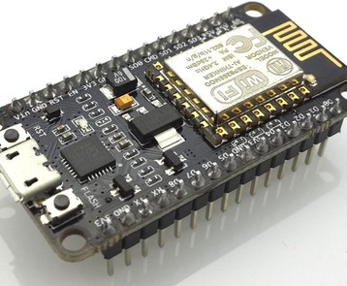
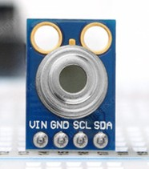
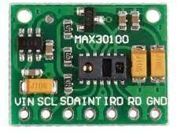
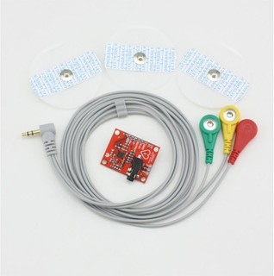
Tools Used
Hardware Requirements :
Node MCU 1.0 ESP8266 Module : Board used to connect our project to WiFi Network.
MX90614 Infrared Temperature Sensor : Sensor Board used to get Temperature Parameter.
MAX30100 Pulse Oximeter : Sensor Board used to get Blood Oxygen Saturation Level Parameter.
AD8232 ECG Monitor Sensor : Sensor Board used to get ECG Parameter.

Slide 11
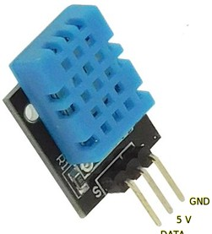
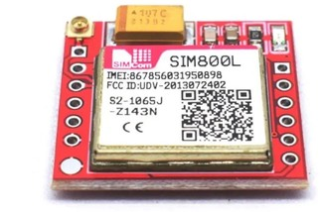
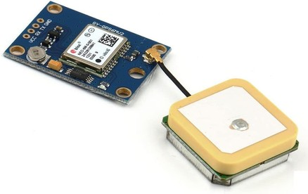
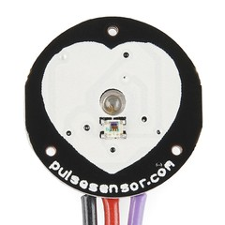
Tools Used
Hardware Requirements :
DHT11 Humidity Sensor : Sensor Board used to get
Humidity Parameter.
SIM 800L GSM/GPRS Module : Board used to send Emergency message / Alerts.
Neo 6M GPS Module : Board used to get live location
(GPS Coordinates) .
Sparkfun Pulse Sensor : Sensor Board used to get
Pulse/BPM Parameter.

Slide 12
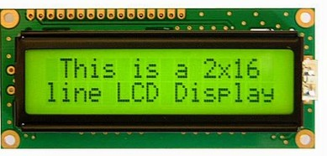
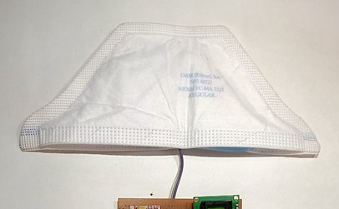
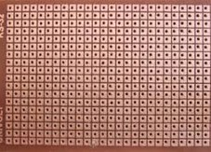
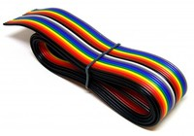
Tools Used
Hardware Requirements :
16 * 2 I2C LCD Module : LCD Display used to display the Parameters locally on the device.
Respiratory Sensor : Self Made Sensor placed inside the mask, used to Measure Respiration Rate.
PCB and Wires: Used for constructing the product .

Slide 13
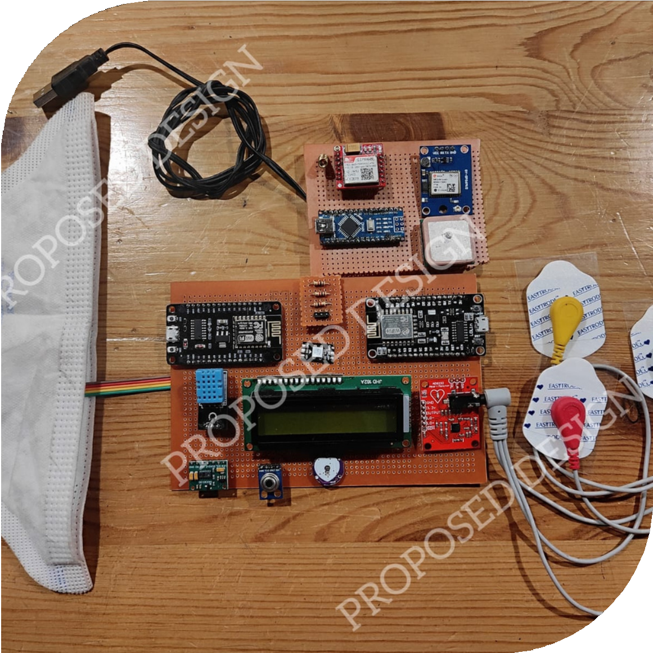
Advantages
Low cost Portable
Low Maintenance Low Operating Cost Easy to Operate
Low Power for Operation
Advantages

Slide 14
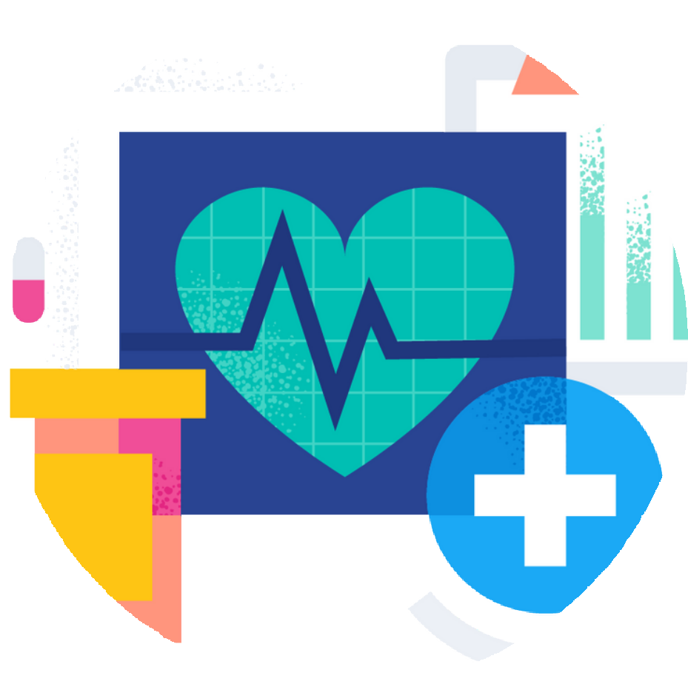
Future Scope
SWASTH
Through connected devices, it becomes easy for doctors and physicians to monitor patients’ health. Also, real-time monitoring can save lives in medical emergencies like diabetic attacks, heart failure, asthma attacks, etc .
Another objective of IoT in healthcare enables operability, machine-to-machine communication, information exchange, and data movement that ultimately makes healthcare facility delivery effective and efficient.
It can be used in case of Remote Medical Assistance where it near impossible to contact a doctor who is available miles away. Conversion to a cost-effective, smart health watch using nanotechnology.
Increase the accuracy Up to 97% which is the Gold Standard in the Smart Healthcare Industry.

Slide 15


